Slide 1

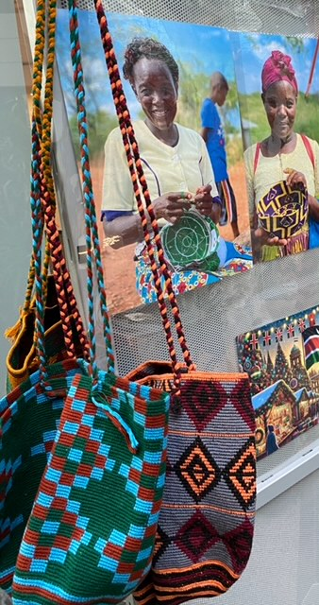
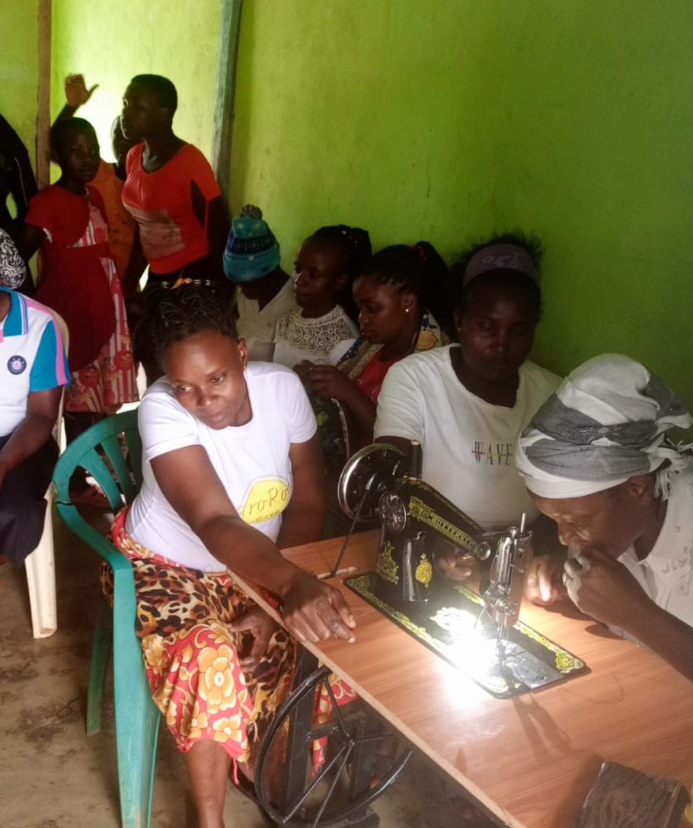
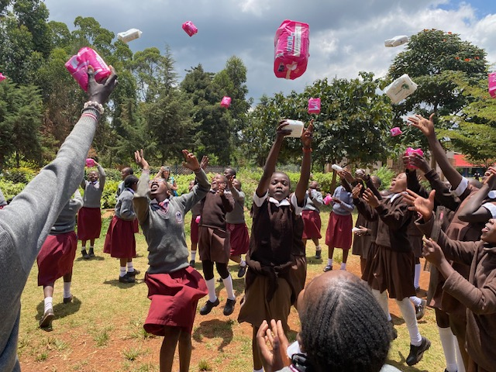
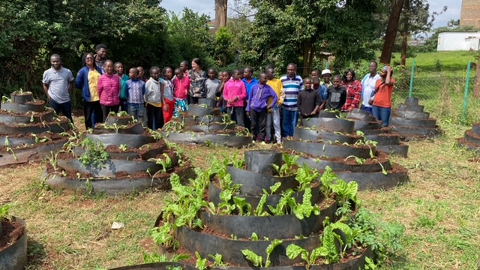
Projects supported in KENYA
WOMEN’S EMPOWERMENT
Baskets of Hope Project that helps women from Tharaka Nithi community becoming more financially independent and sustainable.
Tailoring and Dress Making Projects in Nairobi and Migori county that empower women to be self sustainable.
“Umoja Project” in Samburu: the only women –village in Kenya.
Assistance with education for children, cows, goats and food supply.
“Monthly Talks” with teen girls at St. Clement school, Nairobi
2. Sustainability against hunger
Organic Farming at St. Clement School, Nairobi
Occasional food support: 1400 + people offered a Christmas meal, regular donation of rice, wheat and oil for the communities of Thraraka Nithi and Umoja (Samburu) in Kenya

Slide 2
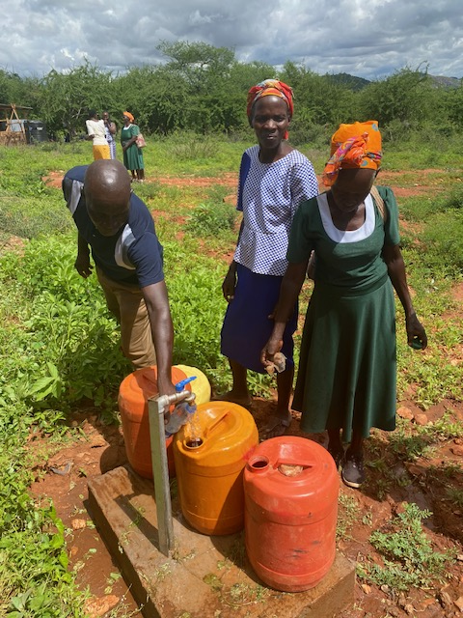
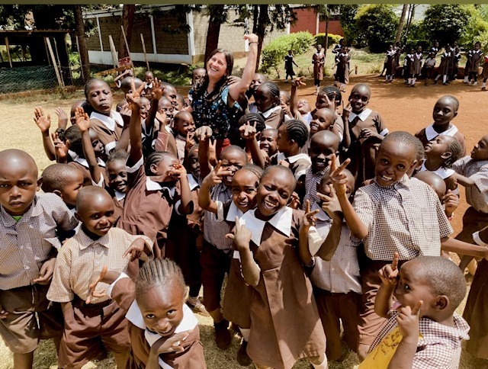
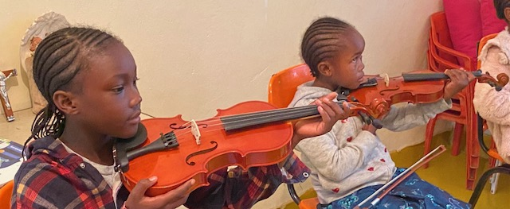
3. Water Project
A borehole was drilled and it is supplying water to four villages in Tharaka Nithi County, Kenya
4. Educate a Child
Action2day sponsors 27 children for school. Education is the key to unlock the golden door of social and economic development in Kenya.
5. Action2day ART Center
Offers a chance to the less privileges ones to have access to violin classes, drawing/paintings classes. 20 children are fully sponsored so far.
Want to help?
6. HEALTH CENTER
www.action2day.org
We need your help in order to build a Health Center for the community from Tharaka Nithii, Kenya
Action2day
ING Bank, Belgium
BE 893632 1355 9785
BIC : BBRUBEBB
PayPal: action2day2021@gmail.com

